Slide 1
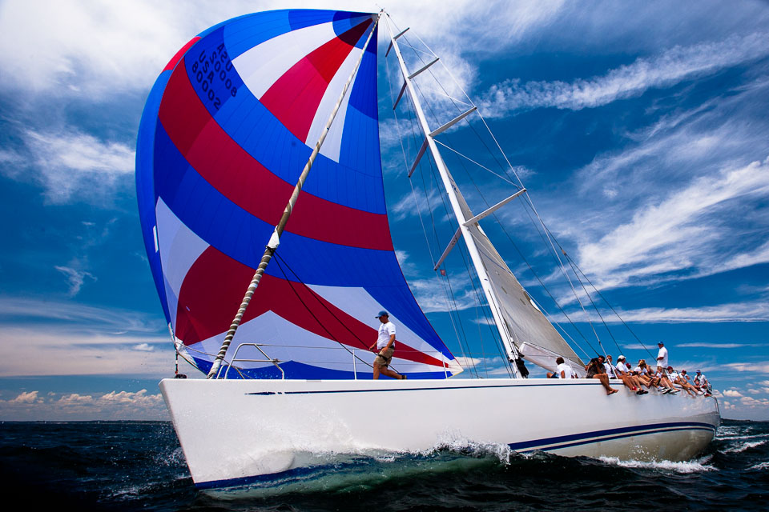
Round the Island Race 2015
Draft Itinerary

Slide 2
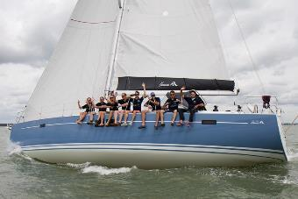
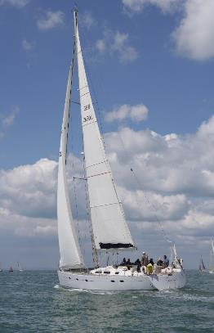
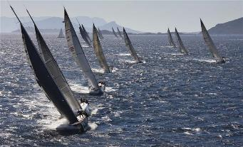
Day 1 - Race Training
09:30 Collection from Hotel/Airport/Train Station 10:00 Champagne reception on the yacht at Port Hamble Marina 10:30 Crew welcome followed by Captains safety & sail briefing 10:45 Set sail from Port Hamble West towards the Needles 11:30 Sail setting, winch training, Spinnaker Hoist and Tacking (training)
A selection of canapés & refreshments are served throughout the morning
LUNCH Dine in style at local Isle Of Wight seafood restaurant ‘The Hut’ in Colwell Bay (Rib pick up)
15:00 An Afternoon of thrilling sailing and race training resumes 16:30 Afternoon tea: a traditional English cream tea is served 17:00 Estimated time of arrival at Cowes Yacht Haven
18:00 Briefing at the Island Racing Club
DINNER 19:00 Folly Inn

Slide 3
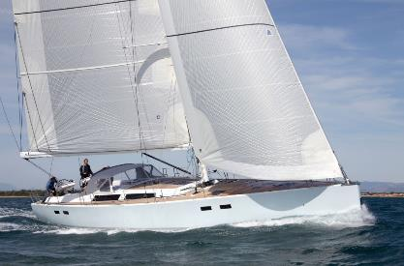
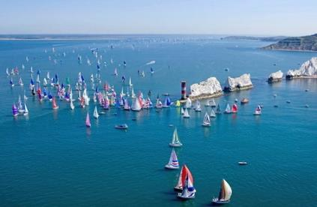
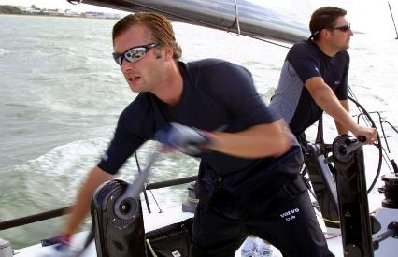
Day 2 – Race Day
AM
06:00 Set sail from Cowes
06:30 Monitor Start Line for best positioning
07:00 Warning Signal 07:10 Race Start (Cannon)
A selection of rolls and croissants will be
served when suitable
08:30 Round the Needles 10:30 Round St Katherines Point under Spinnaker
PM
12:30 Lunch – Catering (Sandwiches)
14:00 Estimated time of arrival at Cowes Yacht Haven 14:30 After race briefing 15:00 Explore Cowes
DINNER in Cowes
20:00 Dinner at Amabi

Slide 4
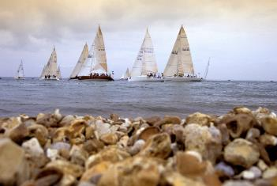
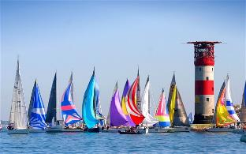
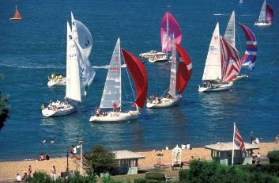
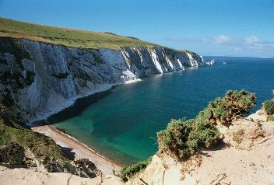
Day 3 - Close
09:30 Depart Cowes 10:00 Anchor for Breakfast (local croissant’s, toast, juice, tea/coffee, fruit salad) in Osborne Bay
11:00 Inflatable rides in Osborne Bay 11:30 Cruising to Hamble 12:30 Arrival at Port Hamble
Taxi pick up for Train Station/Airport
What to bring
Warm clothes (layers), soft soled shoes and sunglasses
Provided on board
Sailing jackets, wet weather gear; safety equipment, sun cream and towels
Refreshments
Snacks, soft drinks, tea and coffee are available throughout the day

